Slide 1


THE ROLE OF YOGA
FOR HEALTHY MIND AND BODY
Presented By
Aaradhya Kannade
Aaraf Ansari
Aaryan Kamdar
Aaryan Joshi
Aaryan Khanna
Aayush Trada
Aayushi Bhat
Adith Shetty

Slide 2

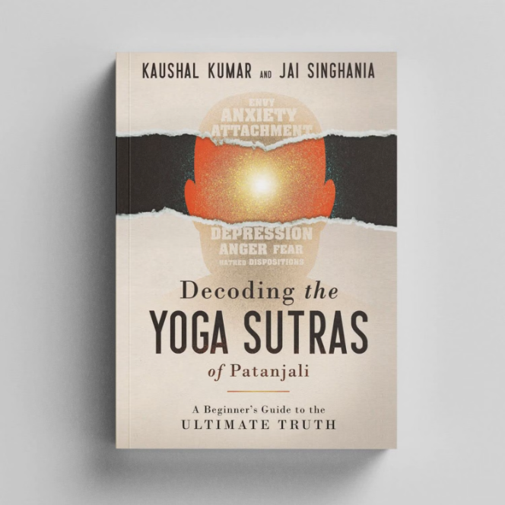
Deciphering the Yoga Sutras: A Deep Dive into "Yogas Chitta Vritti Nirodha" and "Yogah Karmasu Kaushalam"
Deciphering the Yoga Sutras reveals key concepts: "Yogas Chitta Vritti Nirodha" focuses on calming the mind, and "Yogah Karmasu Kaushalam" emphasizes skilled action. These sutras guide yoga practitioners to find peace within and perform actions mindfully.

Slide 3

From Practice to Philosophy: Unveiling Yoga as a Way of Life
Unveiling Yoga as a Way of Life" explores yoga beyond physical exercise. It reveals yoga as a holistic lifestyle encompassing mental, physical, and spiritual aspects. This journey delves into the deeper meaning of yoga, bridging the gap between practice and philosophy for a fulfilling life.

Slide 4

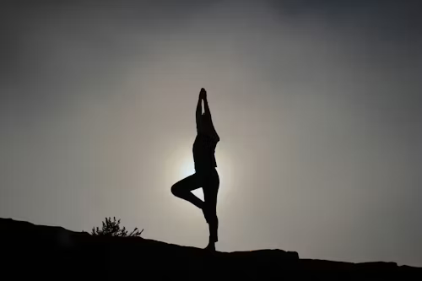


Slide 5

Unveiling the Value of Yoga: Exploring Physical and Mental Wellbeing
Exploring Physical and Mental Wellbeing" uncovers yoga's benefits beyond the mat. It delves into how yoga enhances physical health and mental clarity, promoting overall wellbeing. This exploration highlights yoga as a holistic practice for a balanced and fulfilling life.

Slide 6

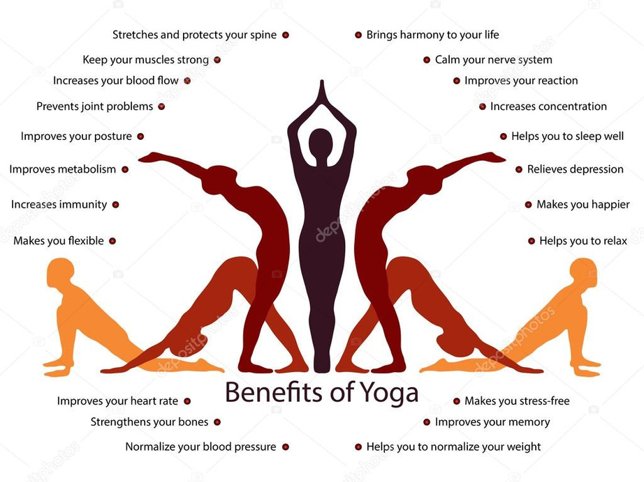


Slide 7

The Eight Limbs of Yoga: Navigating the Ashtanga Path
Navigating the Ashtanga Path" elucidates the comprehensive approach of Ashtanga yoga. It explores the eight limbs, from ethical principles to spiritual enlightenment, guiding practitioners towards holistic growth and self-realization. This journey unveils the rich tapestry of Ashtanga yoga as a path to inner harmony and fulfillment

Slide 8
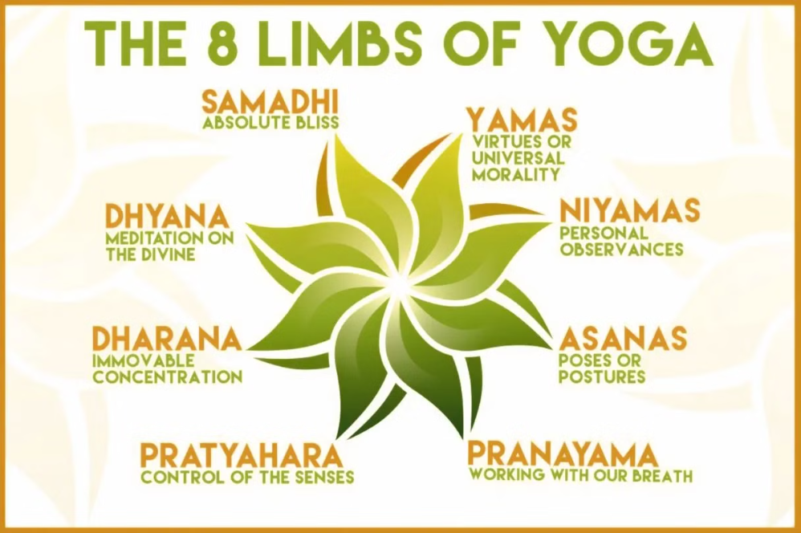

Slide 9

Exploring the Science Behind Yoga: Decoding Research and Analysis
scientific studies reveal stress reduction and cognitive benefits, while its essence lies in personal growth. Let's embrace both empirical evidence and the journey of self-discovery for mindfulness and balance.

Slide 10
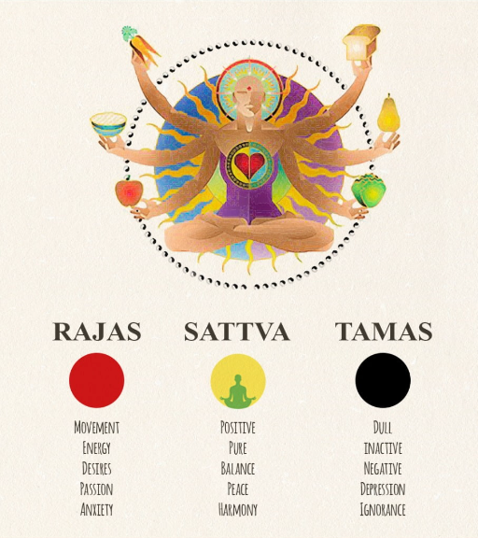
Cultivating a Balanced Life: Integrating Yoga, Gunas, and Food Choices
Integrating Yoga, Gunas, and Food Choices" illuminates the synergy between yoga philosophy, the concept of Gunas (qualities), and dietary habits. It explores how mindful food choices aligned with the Gunas contribute to physical health and mental equilibrium, fostering a harmonious and balanced lifestyle.

Slide 11



Slide 12

Waking Up with Yoga: Exploring the Significance of Brahmurta Practice
Exploring the Significance of Brahmurta Practice" delves into the ancient tradition of Brahmurta, the auspicious time before sunrise. It highlights the importance of starting the day with yoga and meditation during this sacred period, fostering mental clarity, spiritual growth, and overall well-being.

Slide 13


Slide 14

Building a Sustainable Yoga Routine: Tips and Survey Findings
Tips and Survey Findings" offers practical insights into creating a consistent and effective yoga practice. It presents survey findings on common challenges and preferences, accompanied by actionable tips for maintaining motivation, overcoming obstacles, and integrating yoga into daily life sustainably.

Slide 15
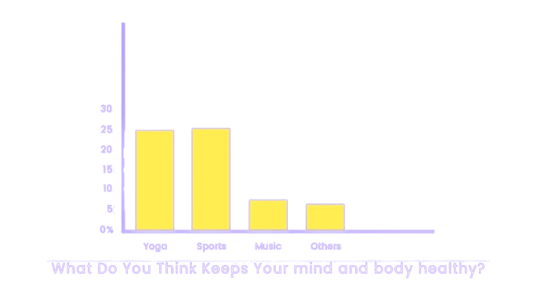

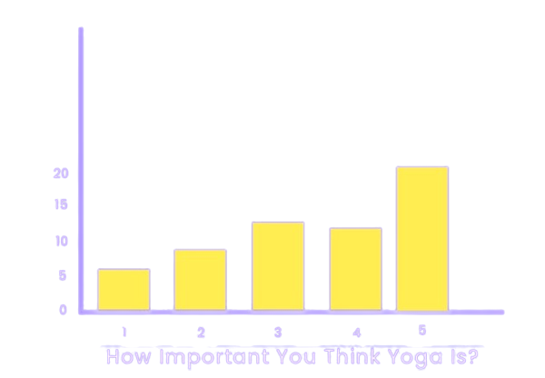

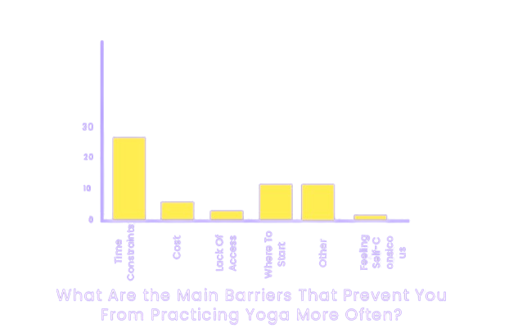

Slide 16
.
Thank You.

